Slide 10



OPERATIONS ON CRISP SETS
UNION:
INTERSECTION:
COMPLEMENT:
DIFFERENCE:
Computer Science and Engineering, VJCET, Vazhakulam

Slide 11
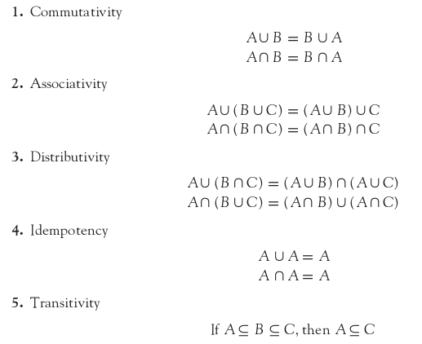
PROPERTIES OF CRISP SETS
The various properties of crisp sets are as follows:
Computer Science and Engineering, VJCET, Vazhakulam

Slide 12
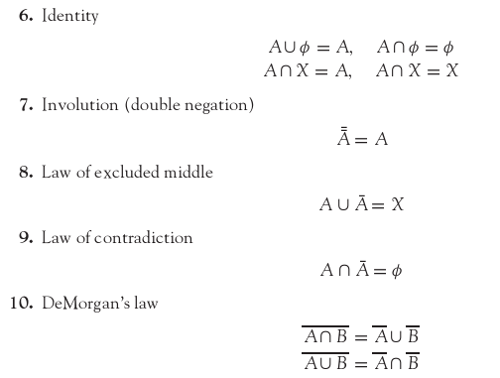
Computer Science and Engineering, VJCET, Vazhakulam

Slide 13
FUZZY SETS
Computer Science and Engineering, VJCET, Vazhakulam

Slide 14
Computer Science and Engineering, VJCET, Vazhakulam

Slide 15

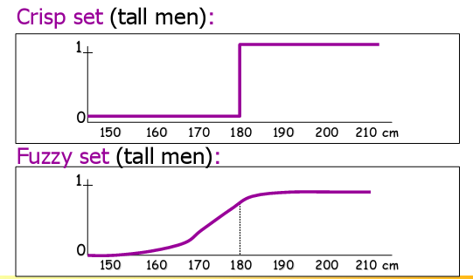
Computer Science and Engineering, VJCET, Vazhakulam

Slide 16
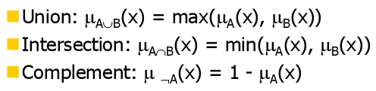
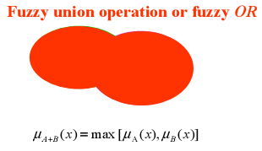
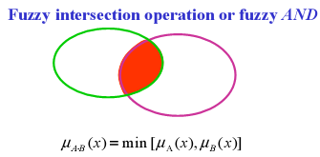
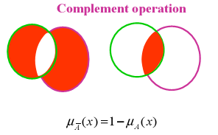
OPERATIONS ON FUZZY SETS
Computer Science and Engineering, VJCET, Vazhakulam

Slide 17
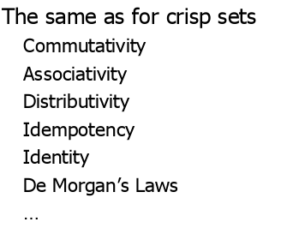
PROPERTIES OF FUZZY SETS
Computer Science and Engineering, VJCET, Vazhakulam

Slide 18
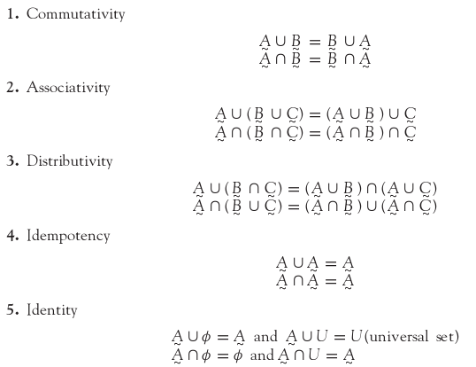
Computer Science and Engineering, VJCET, Vazhakulam

Slide 19
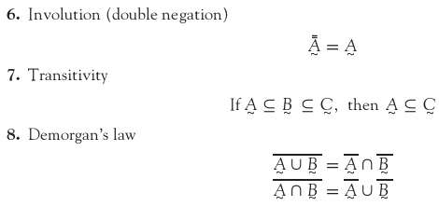
Computer Science and Engineering, VJCET, Vazhakulam

Slide 20
SUMMARY
This chapter discussed the basic concepts of fuzzy logic.
An introduction to crisp sets and fuzzy sets has been included.
The operations and properties of crisp sets and fuzzy sets are also dealt with.
Computer Science and Engineering, VJCET, Vazhakulam

